Slide 1
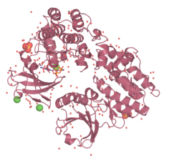
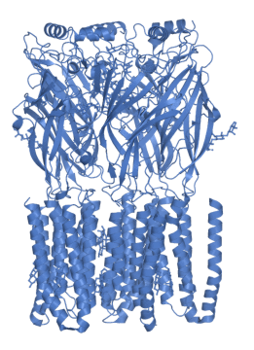
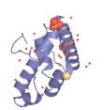
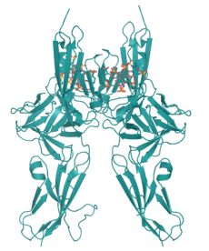
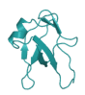
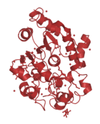
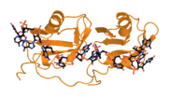
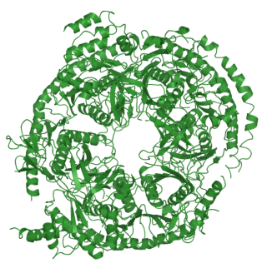
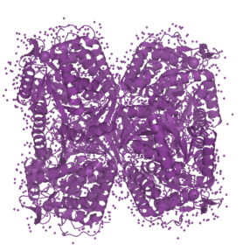
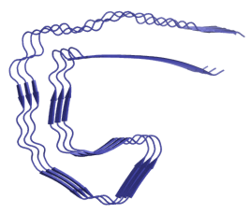
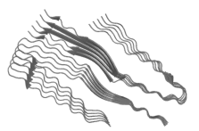
3D Proteins: Structural Insights
Samantha Perez-Miller, PhD
University of Arizona
Center for Innovation in Brain Sciences
Department of Pharmacology
Feb 5, 2020
Notes:
PDBs, clockwise from top left
6d6u (GABA-A receptor)
2n4p (TDP-43, N-terminal domain)
4m69 (MLKL-RIPK3 complex)
3ktr (PAB1)
1fq9 (FGF receptor 1, extracellular domain)
1o02 (ALDH2)
6hre (Tau fragment from Alzheimer’s brain)
6n37 (TDP-43 C-terminal fragment)
2nn6 (RNA exosome)
Inner left of names: 1eh5 (PPT1) and right of names: 4bs2 (TDP-43 RNA binding domains)

Slide 2
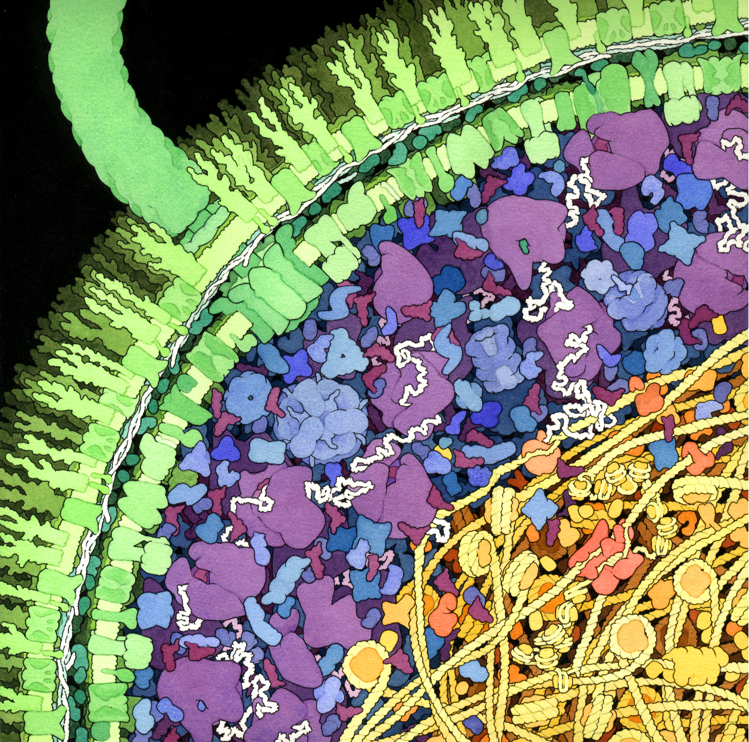
3D Proteins: Structural Insights
Topics
Background
What’s in a Structure?
The RCSB PDB
PyMol: Examine your targets
The Machinery of Life, Figure 4.1 (David S. Goodsell)

Slide 3
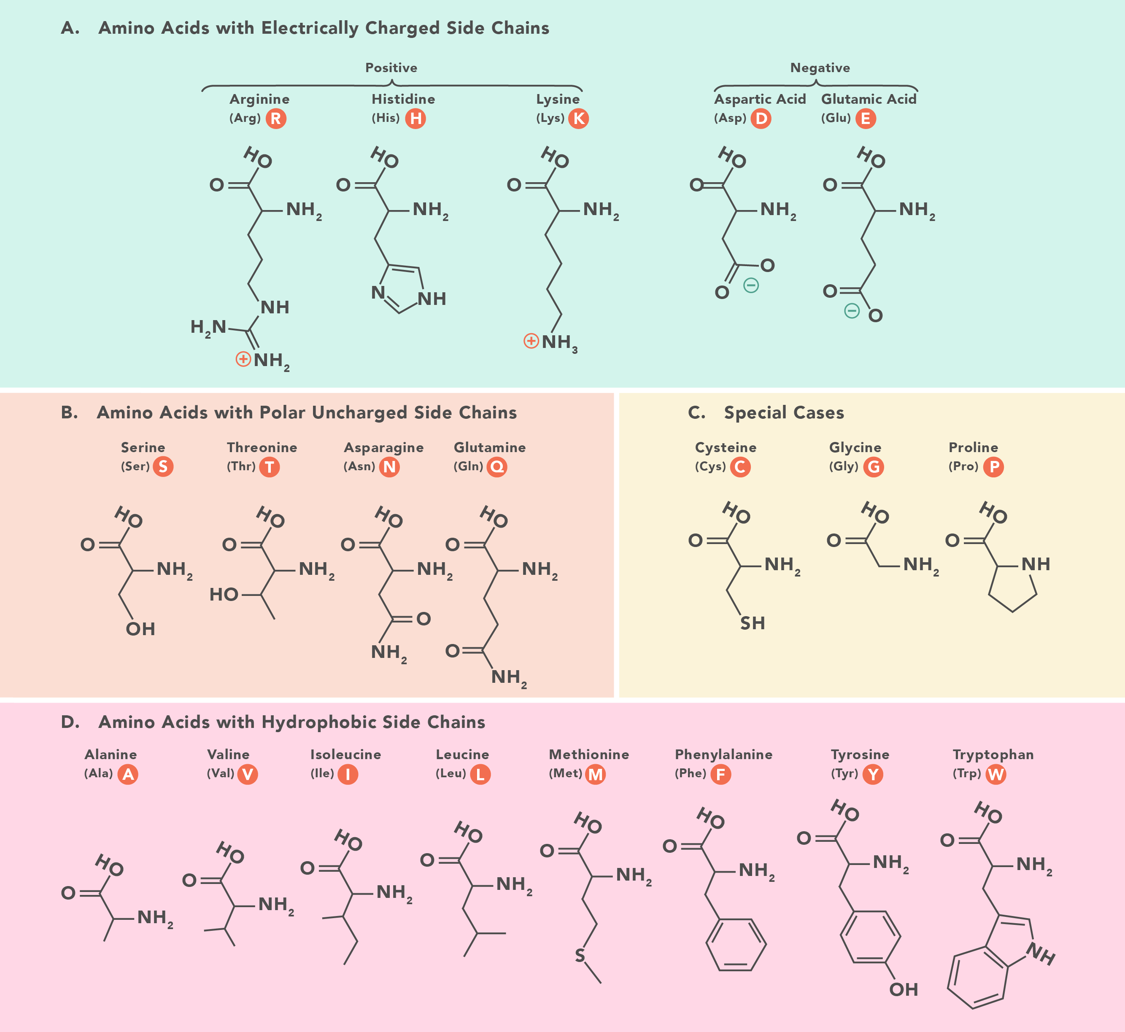
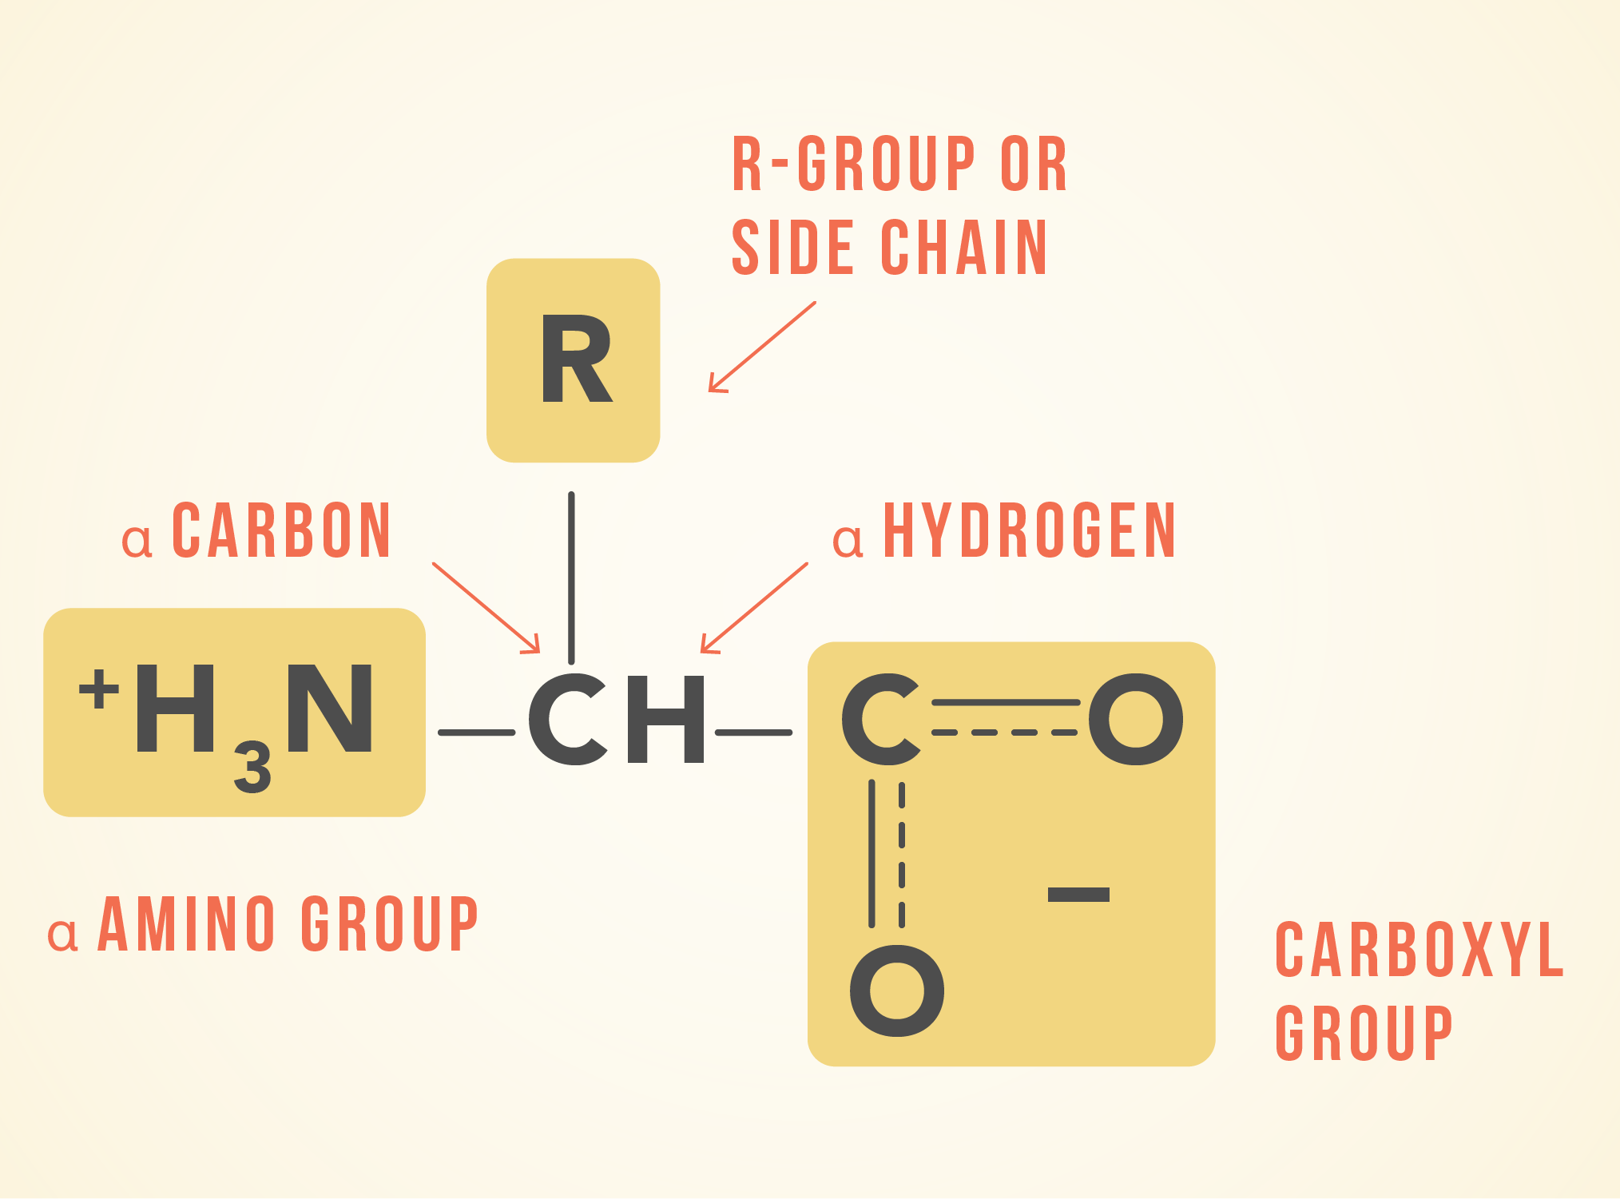
Background
  Amino acid properties
https://www.technologynetworks.com/applied-sciences/articles/essential-amino-acids-chart-abbreviations-and-structure-324357

Slide 4
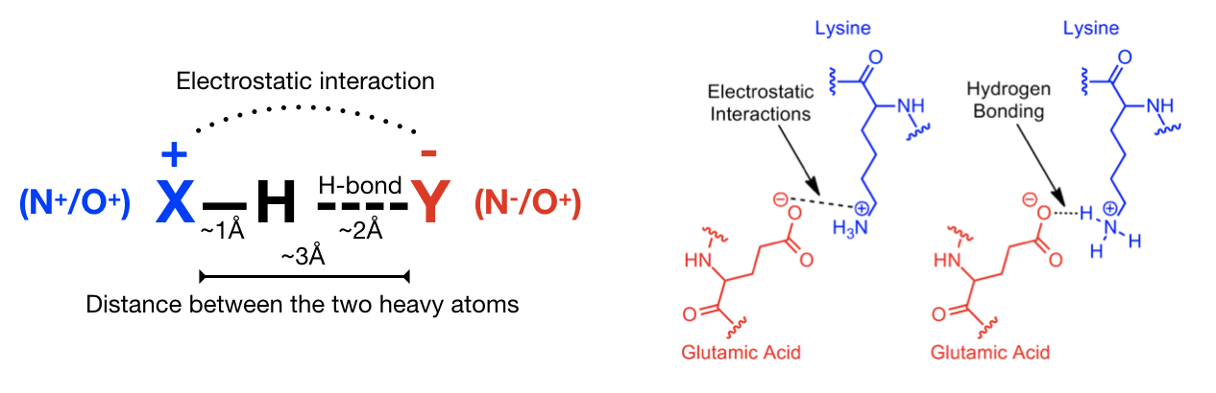
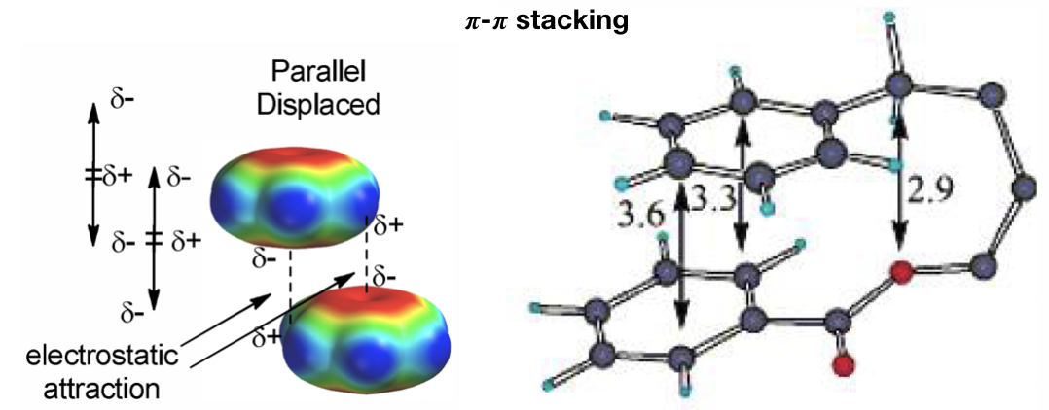
Background
  Amino acid interactions
Interaction | Salt-bridge (ionic) | Hydrogen bond | Hydrophobic (van der Waals)
Amino acids | Charged | Polar and backbone NH and C=O | Hydrophobic and backbone C
Strength | 20 – 40 kJ/mol | 16 – 60 kJ/mol | 2 – 4 kJ/mol
Bond length between heavy atoms (non-H) | 3 – 4 Å | 2.5 – 3.2 Å | 3 – 5 Å
Importance in Drug Design | If present, likely to be important initial interaction as drug enters binding site Stronger in hydrophobic environments | Orientation, specificity Individually weak, strength in numbers | Drug-binding pockets often hydrophobic Contribute to desolvation energy
https://ctlee.github.io/BioChemCoRe-2018/distance-analysis/
Notes:
Covalent bonds – Disulfides ~ 250 kJ/mol; peptide bond ~ 400 kJ/mol
All of the interactions are directional

Slide 5
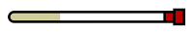

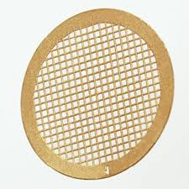
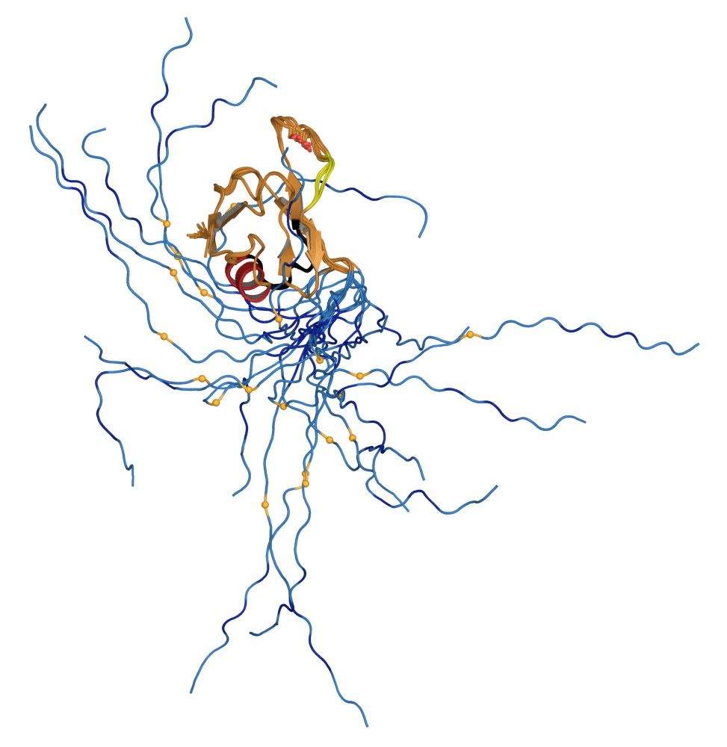
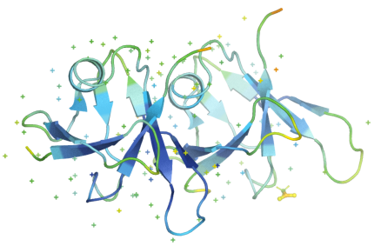
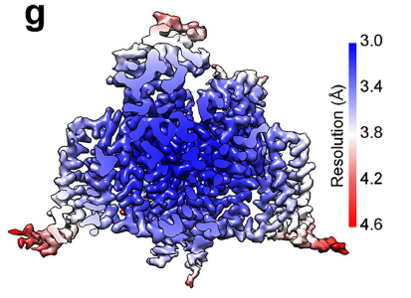
What’s in a Structure?
  What is a Structure?
Method | NMR | X-ray | Cryo-EM | Homology Model
Sample | liquid, room temp | crystal, 100 K | vitreous, 80 K | in silico
Data | 2D resonance spectra | diffraction intensities | 2D images | Borrowed from a homologous protein
Max resolution |  | 0.5 Å | 3.0 Å
Advantages | Captures solution state | High resolution | Large complexes | Useful if no structure is available
Disadvantages | Limited to <25 kDa* | Fixed snapshot | Low resolution, limited to >50 kDa | Structure will look like model
a model for the 3-dimensional arrangement of atoms that best fits the data and satisfies chemical constraints
Notes:
*Usually 5- 25 kDa, but specialized techniques can extend resolution to ~80 kDa in some cases

Slide 6
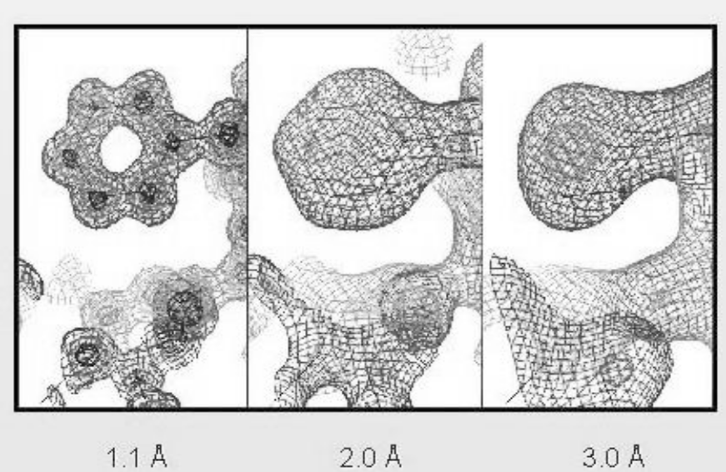
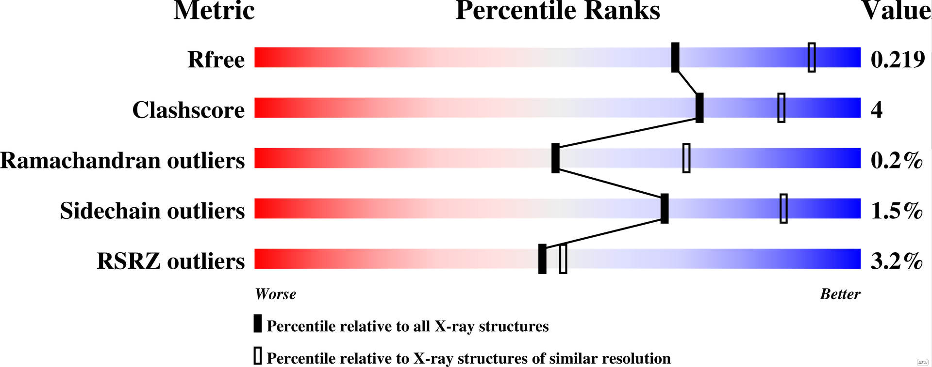
What’s in a Structure?
  Metrics of structure quality (X-ray or cryo-EM)
Resolution: how close atoms can be and still be distinguished
5 Å Helices look like tubes
3 Å β-sheets, most side-chains
2 Å Side-chains, carbonyls
1 Å Atomic resolution
1 Å 2 Å 3 Å
For X-ray or CryoEM
Clashes between atoms (Clashscore)
Distortion of bond angles (Ramachandran)
Rotations of sidechains (Sidechain outliers)
Fit to the data (RSRZ)

Slide 7
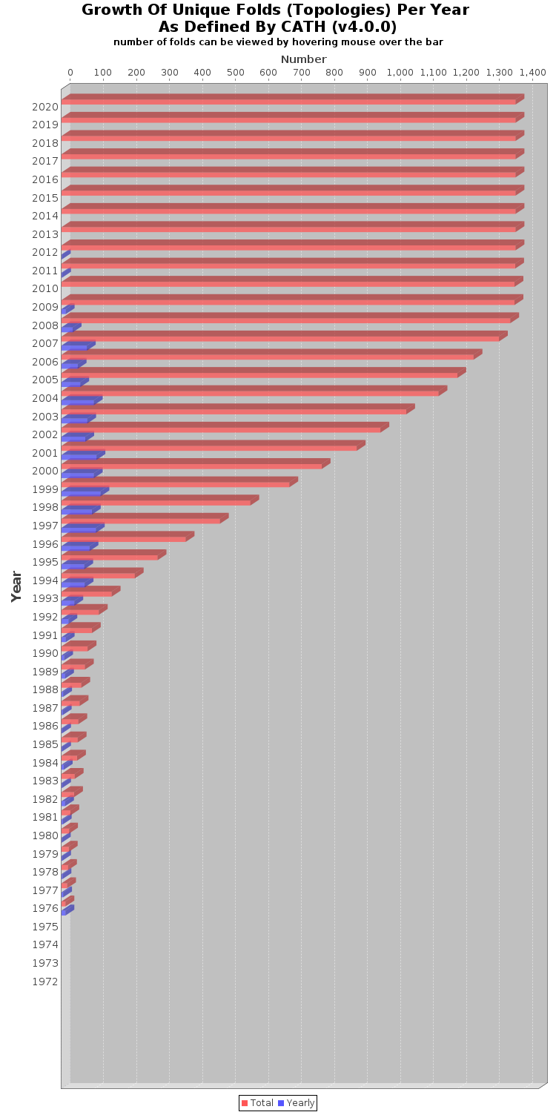
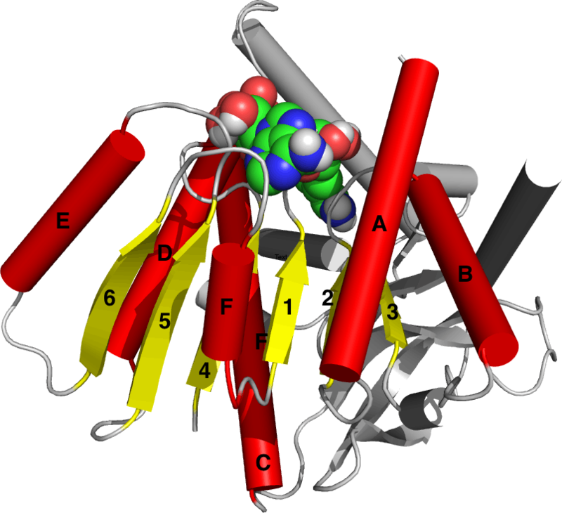
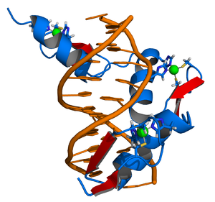
What’s in a Structure?
  Fold and function
Protein folds (domains)
  Arrangements of secondary structure
  Specific functions
Intrinsically disordered domains also functional
Estimates of unique protein folds vary from 4,000 – 20,000
Protein variety achieved by combination of folds (domains)
Only 1,375 unique protein folds have known 3D structures
Rossmann fold
Binds NAD/NADP
Zinc-finger domain
Binds DNA

Slide 8
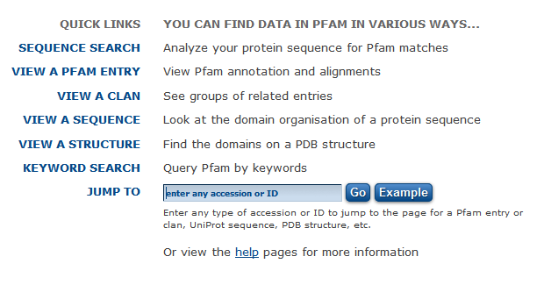
Identify domains (folds) in your target
Domains will be listed in Pfam: https://pfam.xfam.org/
Enter UniProt ID here
PDB Uniprot name
1rk4 O00299 CLIC1 Chloride intracellular channel 1
3rj8 Q9Y5Z4 HEBP2 SOUL protein
5inb P36873 PPP1CC Protein phosphatase 1 (PP1)
5x2L Q9GZT4 SSR Serine racemase
Follow up later with docking results to see which domain(s) your site is in

Slide 9
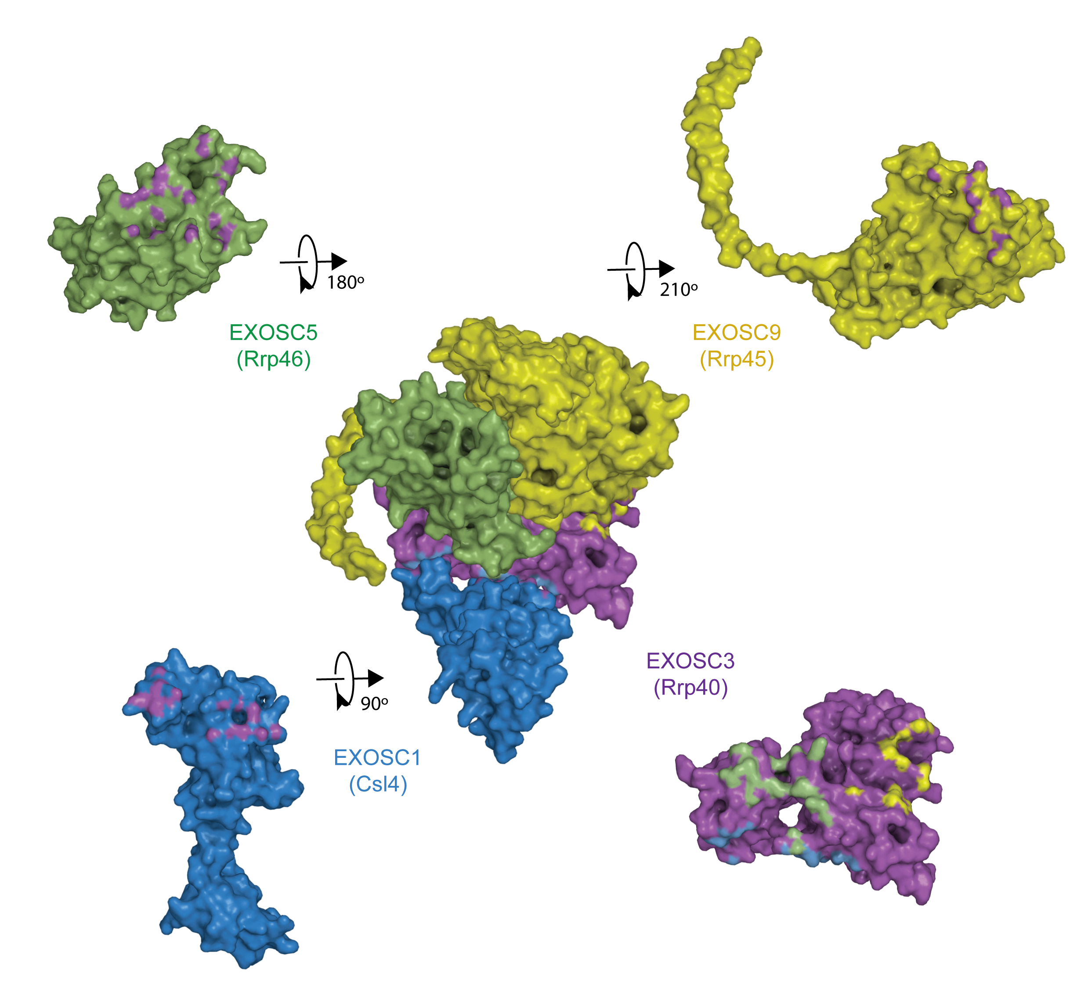
What’s in a Structure?
  Protein-Protein Interactions
All proteins interact in the cell
Mostly transient, for example
  Phosphorylation
  Transcriptional regulation
Some stable (but still dynamic), for example
  Protein complexes
  Membrane-embedded proteins
Mutations can alter PPI
Drug binding can alter PPI
Predict interactions: https://string-db.org/
Follow up later if you haven’t already looked at predicted interacting partners

Slide 10
Things to Consider for Structure-Based Drug Design
Highest resolution possible with highest completeness
  Are there missing domains or gaps?
Is the structure locked in active or inactive state?
Are there mutations present in structure?
Are important post-translational modifications (PTMs) present?
  Rare to find with PTMs
What ligands, metals, cofactors are present in the structure?
  Metals can be involved in ligand binding
  Ligands can provide location of binding site
  Cofactors may be necessary for activity
Was the structure determined near physiological pH?
  Not usually! This can affect charge states of acidic and basic residues in the active site
  Maestro Protein Prep addresses this problem, but other programs do not

Slide 11
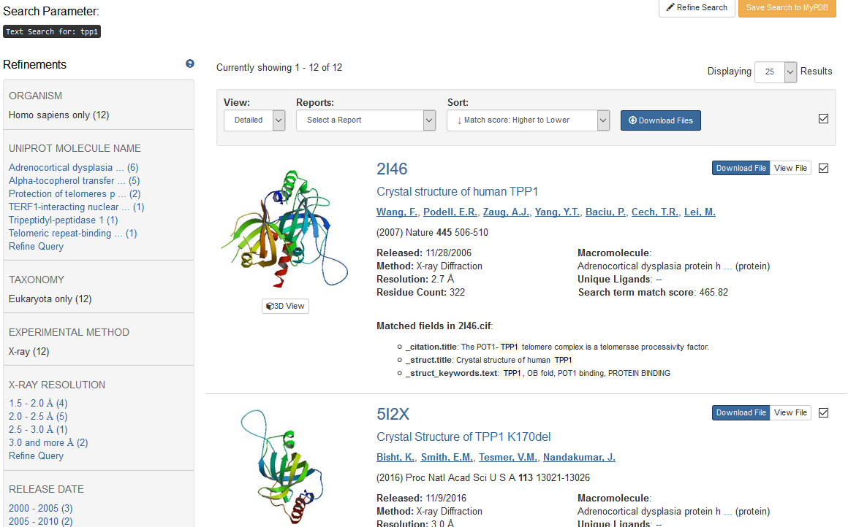
Tour of the RCSB PDB
  Finding a structure
Go to the PDB: https://www.rcsb.org/
Search for TPP1
Ordered by “match” to keyword
6 molecules returned for TPP1

Slide 12
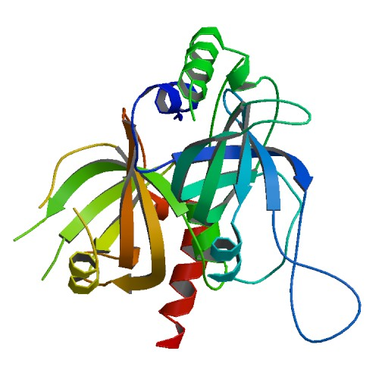
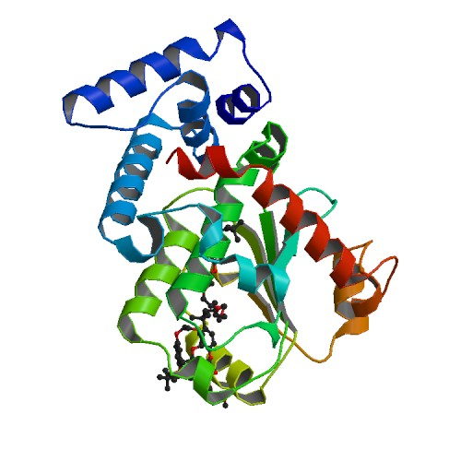
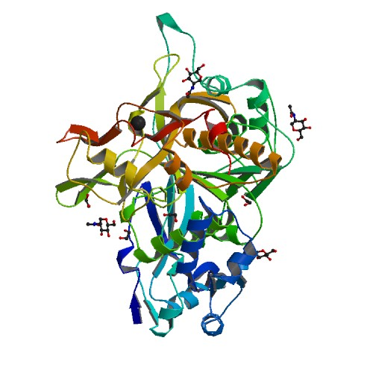
UniProt
  Making sure you have the right target
TPP1
2i46
Q96AP0
Go to UniProt: https://www.uniprot.org/
Standard protein and gene names
Curated information and links
Links to PDB not always up to date
  Sequence ranges are for construct, not what is visible in the structure
Correct Fasta sequence – keep this page open
TPP1
1oiz
P49638
TPP1
3edy
O14773
1rk4 O00299 CLIC1 Chloride intracellular channel 1
3rj8 Q9Y5Z4 HEBP2 SOUL protein
5inb P36873 PPP1CC Protein phosphatase 1 (PP1)
5x2L Q9GZT4 SSR Serine racemase

Slide 13
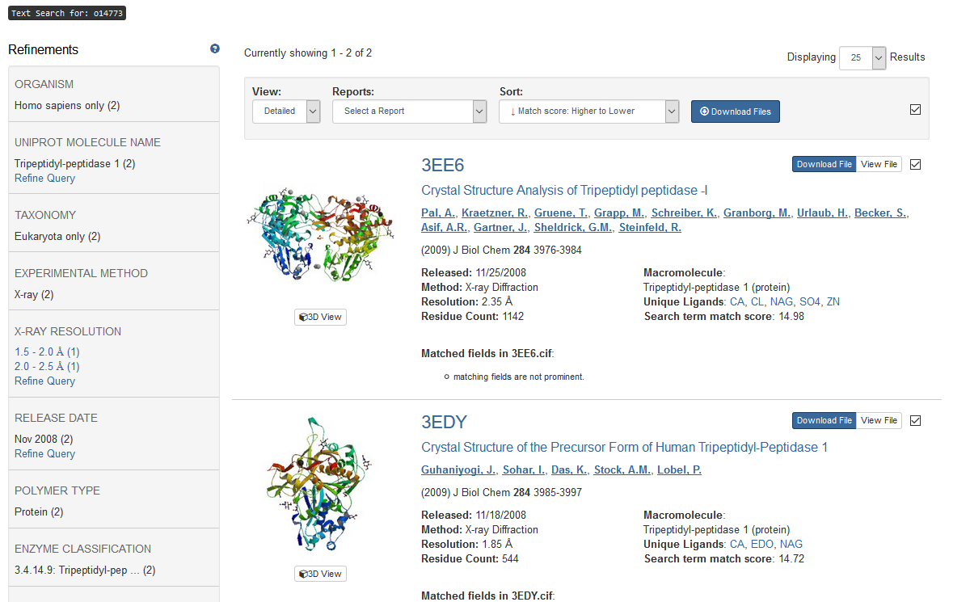
Tour of the RCSB PDB
  Get the best structure
Go back to the PDB and search with the UniProt ID for your target
Searching using O14773 returns only the human form of the target

Slide 14
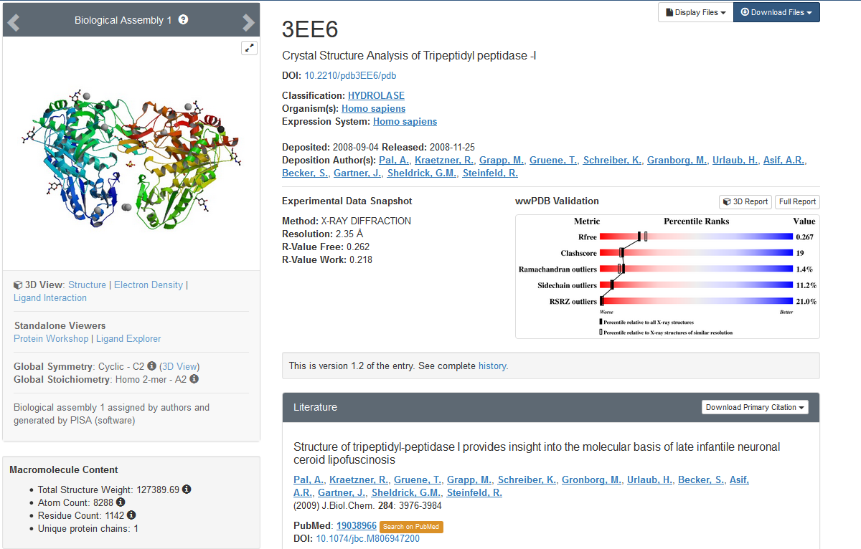
Tour of the RCSB PDB
  Structure summary 1
Biological assembly might not be correct (check publication)
Record
Get reference

Slide 15
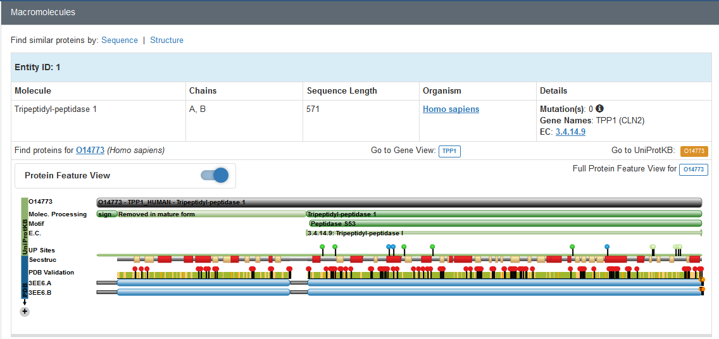
Tour of the RCSB PDB
  Structure summary 2
Record
Record if any
For construct, not contents
Missing from structure

Slide 16
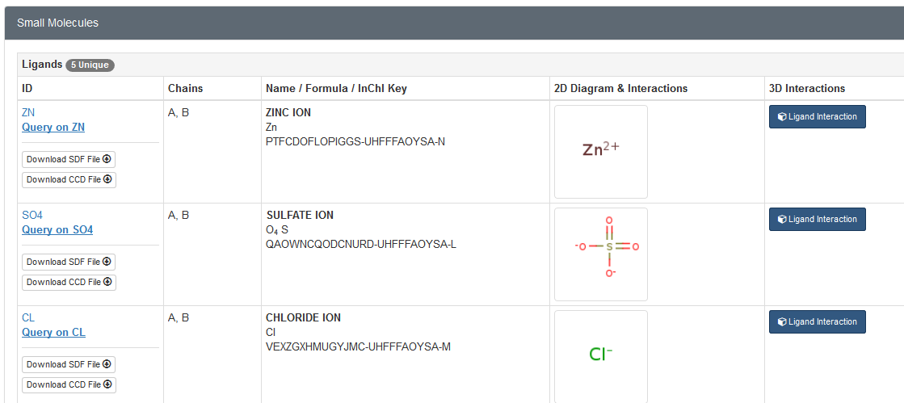
Tour of the RCSB PDB
  Structure summary 3
Record
IDs

Slide 17
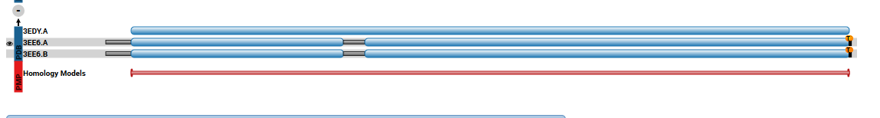
Tour of the RCSB PDB
  Comparing structures
Click
Scroll down on new page and click the + again to see all available structures
If you don’t already have it, download your PDB
If you are working on CLIC1, also download 1k0n
If you are working on SSR, also download 3L6b

Slide 18
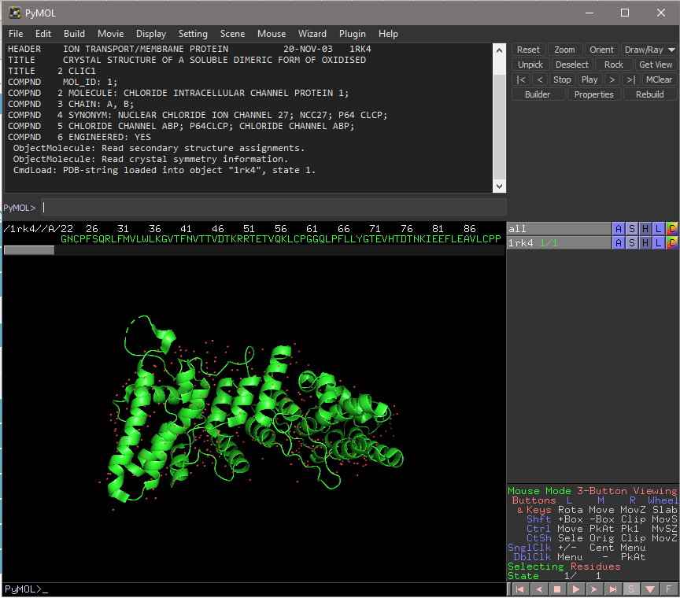
PyMol
  View your targets and check the sequence
Open the PDB file with PyMol
Stop and check the sequence
  Display the sequence: Click s
  Compare to the UniProt sequence
  All targets seem okay!
Small chain breaks shown as dotted lines
  1rk4, 5x21 chain B
Chain breaks also shown in sequence with ---
  5x21 chains A and B
Click the s
Notes:
Navigating (Win)
Middle click on any residue in structure or sequence to center on it
To zoom: hold R-mouse button, drag
To rotate: hold L-mouse button, drag
To slab: scroll wheel

Slide 19
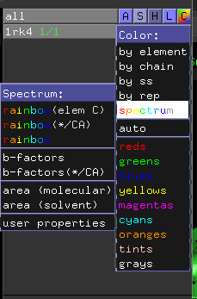
PyMol
  Check the B-factors
B-factors (X-ray structures only) are used in structure determination
B-factors reflect
  thermal motion (vibration)
  static disorder (rotamers)
  problems with crystal (X-ray damage)
High B-factors show regions that are less well-determined
Very high B-factors indicate structural problems
  1rk4, 3rj8, 5inb, 5x2L all look normal
Click the C

Slide 20

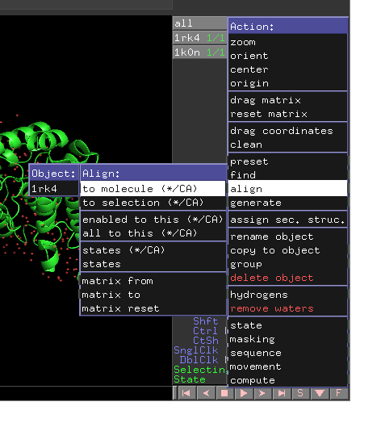
PyMol
  Aligning structures
Click the A (Action) for 1k0n
Simple alignment
1rk4 is a dimer, but it has no ligand present
Another CLIC1 structure has glutathione bound
Download both 1rk4.pdb and 1k0n.pdb
Open 1rk4 with a new PyMol window
File/Open… (select 1rk4)
  1k0n does not have a correct dimer, remove the chain without GSH
    PyMol>remove 1k0n and chain B
    PyMol>save 1k0nA.pdb
Now we want to align the structures
  Click the A (Action) for 1k0n
  Select align/to molecule/1rk4
  RMSD reported in top window (RMSD = 0.506)
    Root Mean Square Deviation
    RMSD ≤ 1.0 means structures essentially identical

Slide 21

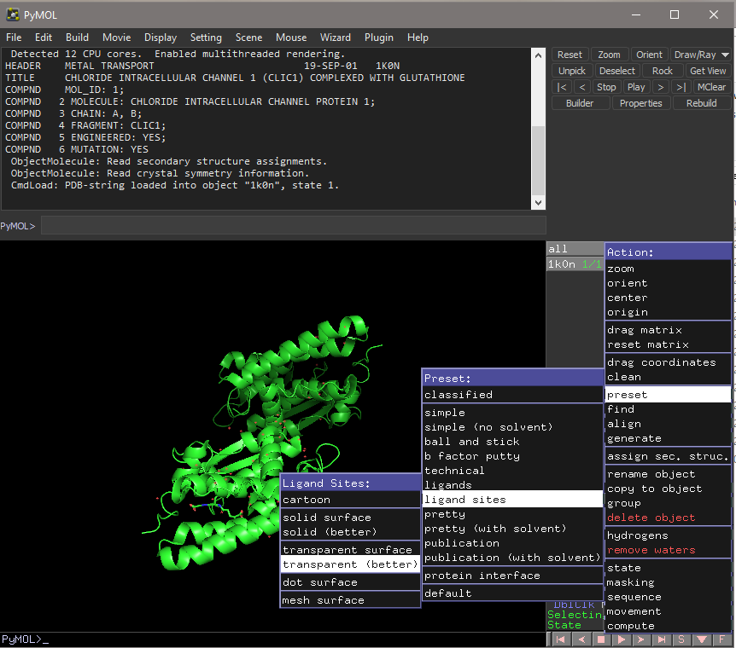
PyMol
  Display existing ligands
Click the A (action) for the object (not for All)
Ligand Sites Using Presets (use your target now)
A/preset/ligand sites/transparent (better)
  5inb has a bunch of glycerol
    PyMol>remove resn GOL
    PyMol>save 5inb.pdb
  For 5x2l remove chain B:
    PyMol>remove 5x2l and chain B
    PyMol>save 5x2lA.pdb
  1rk4 has no ligands, use 1k0nA

Slide 22

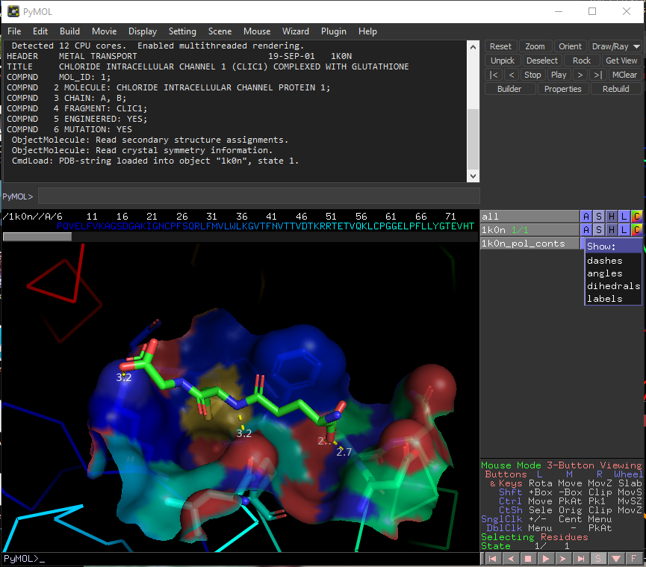
PyMol
  Examine existing ligands
Click the S for the pol_conts object
Ligand sites preset, continued
Shows polar contacts (yellow dashes)
To display distances to amino acids
  Click S (Show) and click on labels
Click on amino acids to identify & record
  Highlighted in sequence and shown in upper window, for example:
“You Clicked /1k0n//A/LEU’64/O”
Note: Presets control colors, representation
Save session files for later use
  File/Save Session
    Name the file pdb-ligand-sites.pse
  Or
    PyMOL>save pdb-ligand-sites.pse

Slide 23
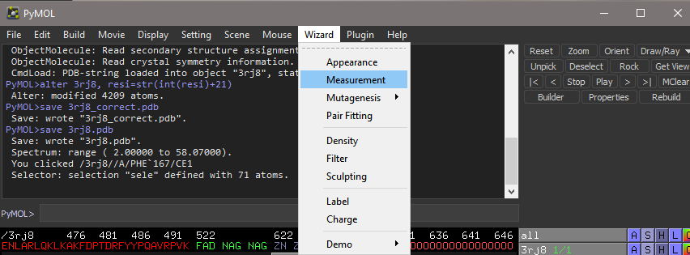
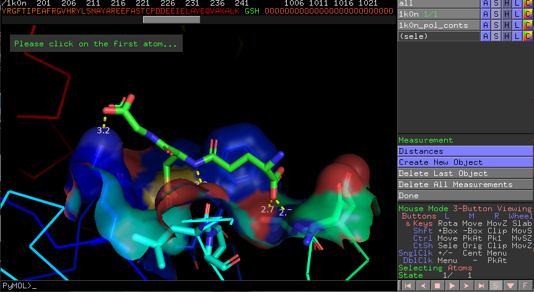
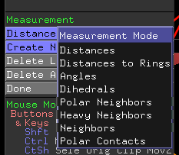
PyMol Practical Session
  Making measurements
Top menu this time: Wizard/Measurement
New panel opens up
Click on Distances to change measurement mode
  Example: Distances to Rings allows you to measure distance to center of plane of the ring
Click on each pair of atoms
Click Done when you are finished

Slide 24
PyMol Practical Session
  A few notes…
PyMol is Python-based (a scripting language)
All commands and settings act on top of whatever has been done before
  Sometimes this interferes with something else you want to do
    Especially problematic after using a preset (from A/preset)
  Save your session (File/Save Session)
  Close PyMol
  Open the pdb again for the next demo
If you removed chains, make sure to open the saved pdb file

Slide 25
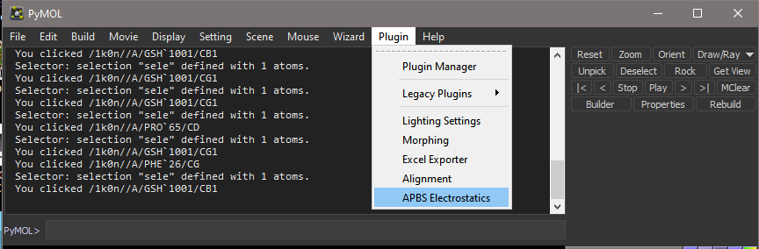
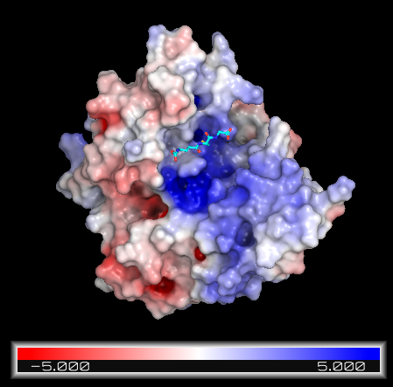
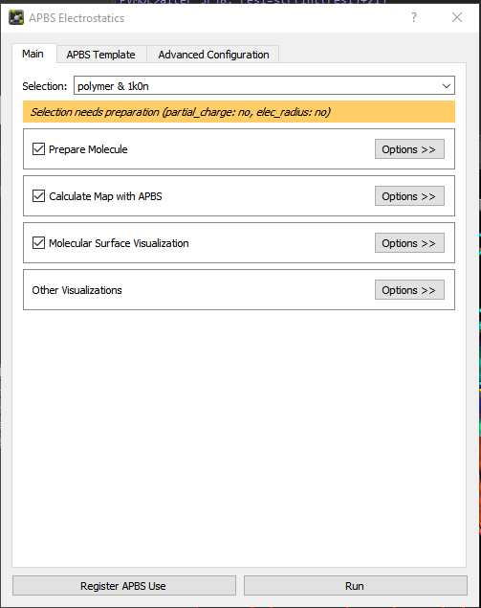
PyMol Practical Session
  Generate electrostatic surface
Top menu: Plugin/APBS Electrostatics
  New window opens up
  Use defaults for now*, click Run
  … warnings. Continue? (Yes)
  Close the final dialog box
This is an approximate electrostatic surface
For better surface display
  PyMol>set surface_quality, 1
If your computer is too slow, reset with
  PyMol>set surface_quality, 0
To hide waters
  PyMol>hide nonbonded
Surface display automatically excludes ligands
  Examine your protein
  Can you identify any potential binding pockets?
negative
positive
Notes:
*For group with 1rk4 with 1k0n also present, Selection needs to be changed to polymer & 1k0n

Slide 26

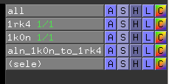
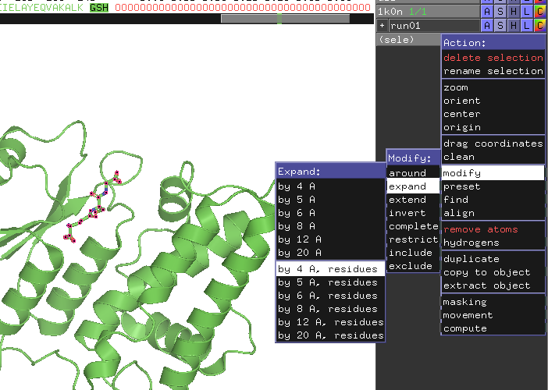
PyMol Practical Session
  Display contacts without using presets
Turn surface off by clicking the object label
Click on ligand to select it
Click the A next to the (sele)
  Select modify/expand/by 4 A
  Click A again, then rename selection
  use keyboard to rename the selection
  S/sticks to show sticks for the expanded selection
Use Wizard/Measurement to find/show distances
  PyMol>hide label
Turn electrostatic surface back on & examine
Save session file
  File/Save Session
  Name the file pdb-electrostatics.pse
  Or
    PyMOL>save pdb-electrostatics.pse

Slide 27

PyMol Practical Session
  Making figures
Download Basic-Settings.pml from Box
You can open this file with a text editor to see the commands (look up on PyMol WIKI to learn more)
  PyMOL>run Basic-Settings.pml
Move your molecule around to get the view you want to show
To make a high-quality image
  PyMOL>ray
To save the image (at default of 150 dpi)
  PyMOL>png filename.png
For PyMol help, go to the WIKI: https://pymolwiki.org/index.php/Main_Page

Slide 28
Follow up
  Docking results
PyMol can open .mae and .maegz files output by Maestro
Examine your docking results in PyMol
Compare the site you targeted to the site(s) you found by visually examining the electrostatic surface
Analyze contacts and make figures for your Pitch!

